Slide 1
Research Proposal
OpenId Connect Protocol Security risk analysis in Cloud-based applications

Slide 2
Significance/Contribution to the Discipline/Research Problem
Scalability demands in the cloud concerning authorisation.
General security risks associated with the Openid Connect protocol will be discussed.

Slide 3
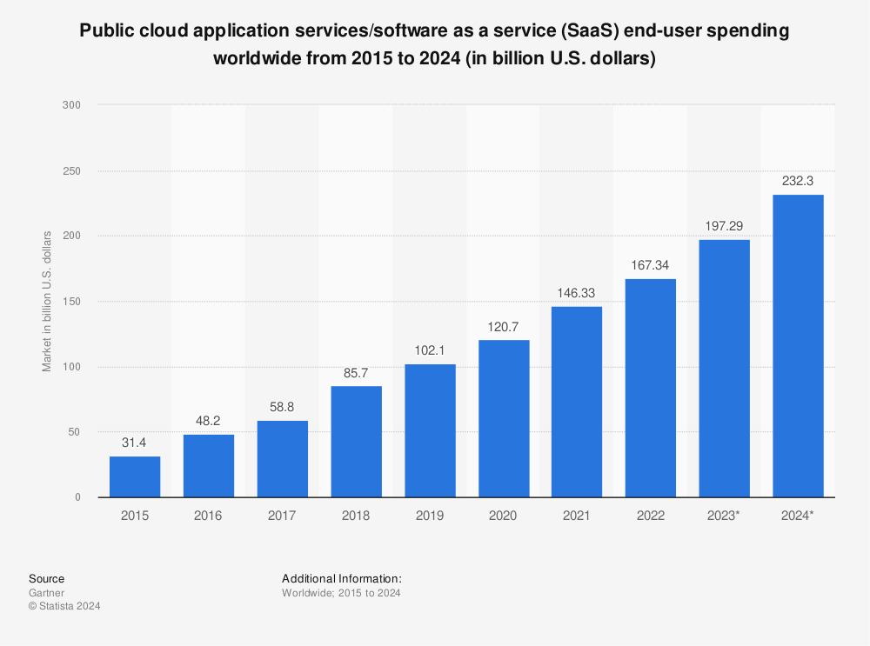
Significance/Contribution to the Discipline/Research Problem
Vailshery, L.S. (2024)

Slide 4
Research Question
What are the primary security vulnerabilities of the OpenID Connect protocol when implemented in cloud-based applications, and how do they impact overall system security?

Slide 5
Aims
What are the possible security risks of using OpenID protocol in a cloud-based environment and possible mitigations.
Risks Including:
Single-Point of failure
Phishing Attacks to steal tokens
Session Hijacking

Slide 6
Objectives
Analyse potential vulnerabilities when scaling these protocols for millions of users.
Provide an approach how to incorporate OIDC protocol in a cloud environment with its main features.
Develop a prototype which contains the main findings and important features from the investigation.

Slide 7
Key literature related to the project
An Analysis of Open Standard Identity Protocols in Cloud Computing Security Paradigm (Naik N, Jenkins P, 2016).
Oauth documentation (Lodderstedt et al. 2013).
Cloud Computing Security Risks: Identification and Assessment Security Concerns Cloud (Patel, K. and Alabisi, A., 2019).
Cloud Security Service for Identifying Unauthorized User Behaviour (David et al., 2022)
Analyzing Privacy Implications and Security Vulnerabilities in Single Sign-On Systems: A Case Study on OpenID Connect. (Al Shabi, M. and Marie, R.R., 2024)

Slide 8
Methodology/Development strategy/Research Design
Literature Review
How OIDC is currently implemented in cloud environments.
Previous findings on OIDC vulnerabilities and attack vectors.
Existing security measures and their effectiveness.
Data Collection
Case Studies
Expert Interviews
Risk Analysis
Qualitative Analysis
Quantitative Analysis
Prototype design and implementation

Slide 9
Ethical considerations
PII data handled in the context of authentication follows the data privacy law GDPR
Explore if users are adequately informed of data sharing, authentication risks, and implications.

Slide 10
Description of artefacts
Risk Assessment with threat modelling, threat scoring, and mitigation strategies.
System design/architecture.
Prototype application is implemented.
Pen-test scanning with security tools.

Slide 11
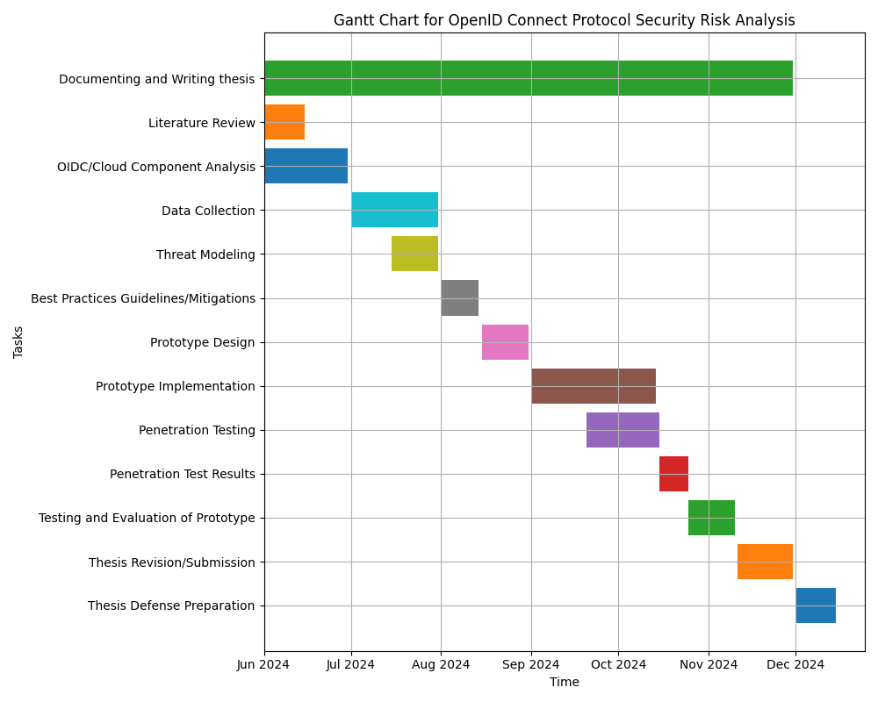
Timeline

Slide 12
References
Al Shabi, M. and Marie, R.R., 2024. Analyzing Privacy Implications and Security Vulnerabilities in Single Sign-On Systems: A Case Study on OpenID Connect. International Journal of Advanced Computer Science & Applications, 15(4).
David, D.S., Anam, M., Kaliappan, C., Selvi, S., Sharma, D.K., Dadheech, P. and Sengan, S., 2022. Cloud Security Service for Identifying Unauthorized User Behaviour. Computers, Materials & Continua, 70(2).
Lodderstedt, T., McGloin, M. and Hunt, P. (no date) RFC 6819: Oauth 2.0 threat model and security considerations, IETF Datatracker. Available at: https://datatracker.ietf.org/doc/html/rfc6819 (Accessed: 18 May 2013).

Slide 13
References
Naik N, Jenkins P. An analysis of open standard identity protocols in cloud computing security paradigm. In2016 IEEE 14th Intl Conf on Dependable, Autonomic and Secure Computing, 14th Intl Conf on Pervasive Intelligence and Computing, 2nd Intl Conf on Big Data Intelligence and Computing and Cyber Science and Technology Congress (DASC/PiCom/DataCom/CyberSciTech) 2016 Aug 8 (pp. 428-431). IEEE.
Patel, K. and Alabisi, A., 2019. Cloud computing security risks: Identification and assessment. The Journal of New Business Ideas & Trends, 17(2), pp.11-19.
Vailshery, L.S. (2024) SAAS market size worldwide 2024, Statista. Available from: https://www.statista.com/statistics/505243/worldwide-software-as-a-service-revenue/ (Accessed: 14 May 2024).

Slide 14
Thank You

